Slide 1

Game #7

Slide 2

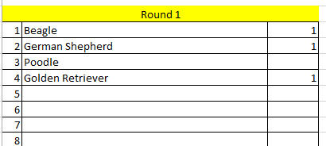
Directions:
A category will be given to you. Type as many answers as you can—things that that category makes you think of. When time is up, ten items will be listed. You get 1 point for every item on your list that matches the list provided.

Slide 3

Top 10 Best Selling Recording Artists
(of all time)
1

Slide 4


Slide 5
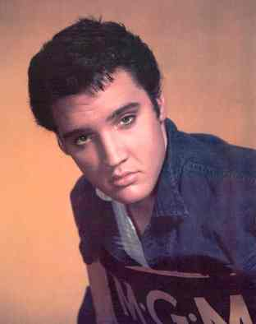

Top 10 Best Selling Recording Artists
Beatles
Garth Brooks
Elvis Presley
Led Zeppelin
Eagles
Billy Joel
Michael Jackson
Elton John
Pink Floyd
AC/DC

Slide 6
Shades of Green
2

Slide 8
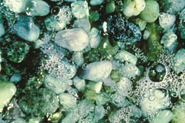
Shades of Green
Forest
Sage
Grass
Neon
Lime
Olive
Chartreuse
Light
Pine
Sea

Slide 9
Rivers
(Worldwide)
3

Slide 11
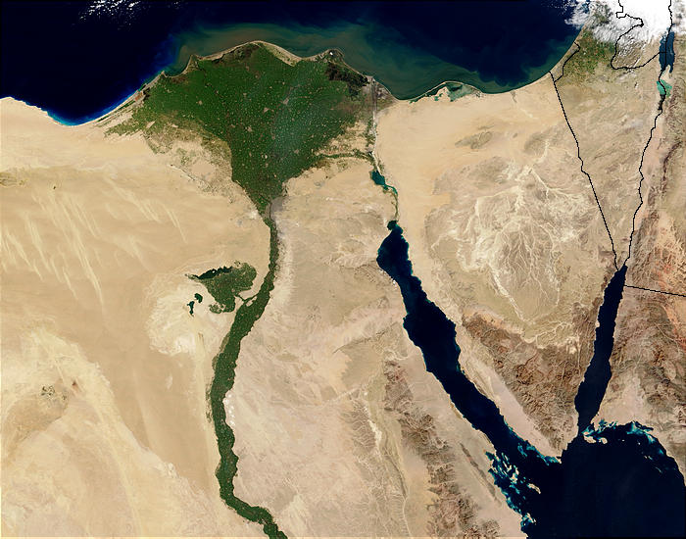
Rivers
Nile
Yellow
Mississippi
Green
Colorado
Congo
Amazon
Seine
Hudson
Thames

Slide 12
Gemstones
4

Slide 14
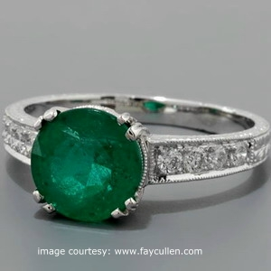
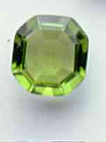
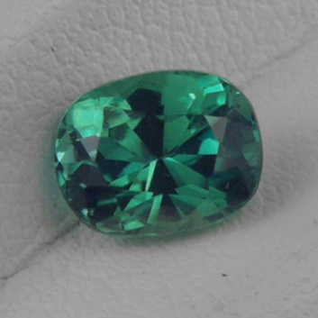
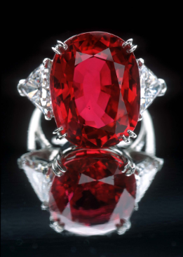
Gemstones
Emerald
Ruby
Diamond
Garnet
Pearl
Topaz
Sapphire
Amethyst
Aquamarine
Peridot

Slide 15
Computer Animated Movies
5

Slide 17
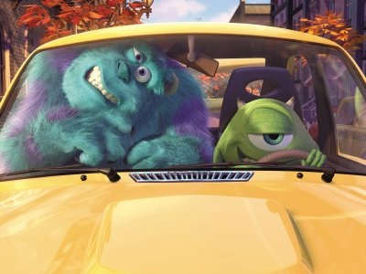
Computer Animated Movies
Toy Story
Monsters Inc.
Cars
Frozen
Finding Nemo
Up
Tangled
Moana
Brave
Shrek

Slide 18
Popular Vacation Spots
6

Slide 20
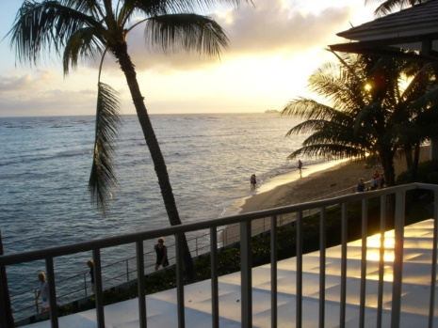
Popular Vacation Spots
Hawaii
Bahamas
Disney World/Land
Malibu
Las Vegas
London, England
Grand Canyon
New York City
Paris, France
Mexico

Slide 21
Disney Villains
7

Slide 23
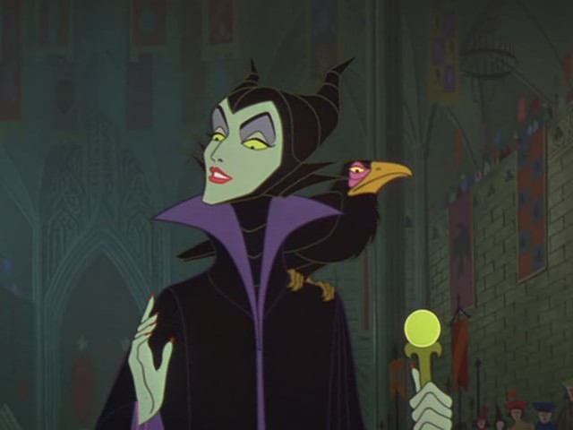
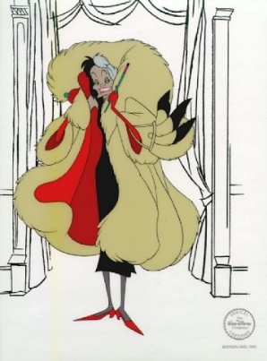
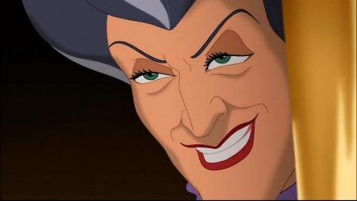
Disney Villains
Maleficent
Jafar
Ursula
Captain Hook
Cruella DeVille
Lady Tremaine (evil step-mother)
Queen of Hearts
Scar
Hades
Mother Gothel

Slide 24
World
Languages
8

Slide 26
World Languages
Spanish
German
French
English
Japanese
Mandarin
Cantonese
Italian
Finnish
Dutch

Slide 27
Types of Clothing
9

Slide 29
Types of Clothing
Hats
Shirts
Pants
Gloves
Shoes
Ties
Suits
Skirts
Dresses
Shorts

Slide 30
Famous NBA Stars
(Past and Present)
10

Slide 32
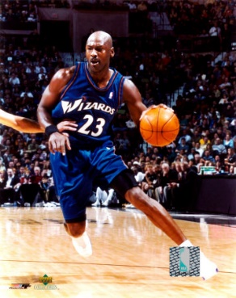
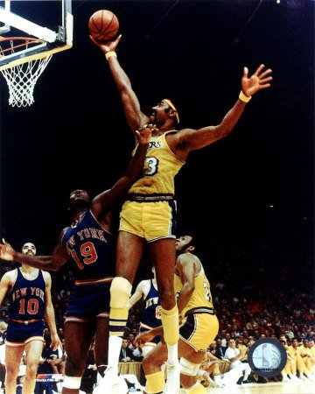
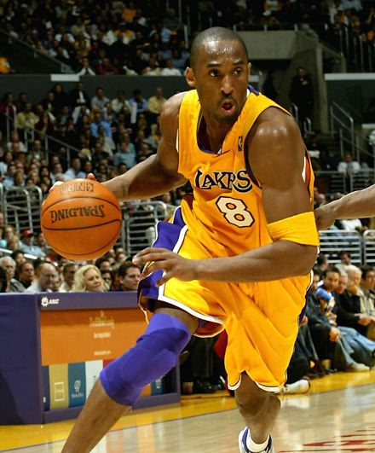
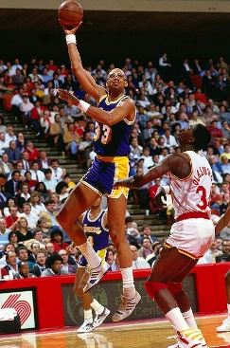
Famous NBA Stars
Wilt Chamberlain
Kobe Bryant
Michael Jordan
LeBron James
Steph Curry
Karl Malone
Shaquille O’Neal
Magic Johnson
Kareem Abdul-Jabbar
Kevin Durrant

