Slide 1
Game #6

Slide 2
Presidents of the United States
1

Slide 4
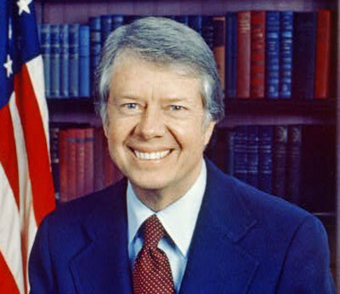
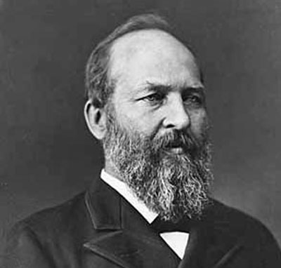
Presidents of the United States
George W. Bush
Bill Clinton
George Washington
Abraham Lincoln
Jimmy Carter
Ronald Reagan
Andrew Jackson
Thomas Jefferson
Barack Obama
Donald Trump

Slide 5
Favorite Teen Name Brands
2

Slide 7
Favorite Teen Name Brands
Aeropostale
Forever 21
Converse
Adidas
Nike
Vans
Volcom
DC
Underarmour
Abercrombie & Fitch

Slide 8
TV Game Shows (not reality)
3

Slide 10
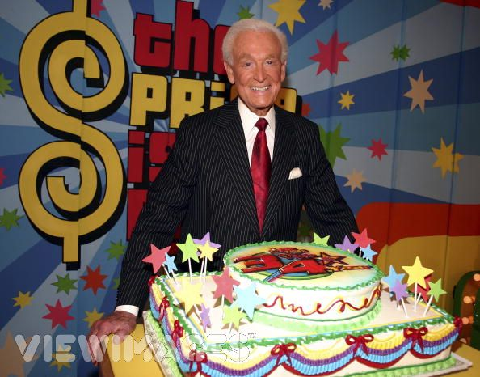
TV Game Shows
Family Feud
The Price is Right
Let’s Make a Deal!
Brain Surge
Wheel of Fortune
Jeopardy
The Wall
Minute to Win It
Who Wants to be a Millionaire?
Ultimate Ninja Warrior

Slide 11
Most Popular Apps
4

Slide 13
Most Popular Apps
Snapchat
Youtube
Facebook
Instagram
Google Maps
Netflix
Bitmoji
Amazon
Spotify
Uber

Slide 14
Parts Under the Hood
5

Slide 16
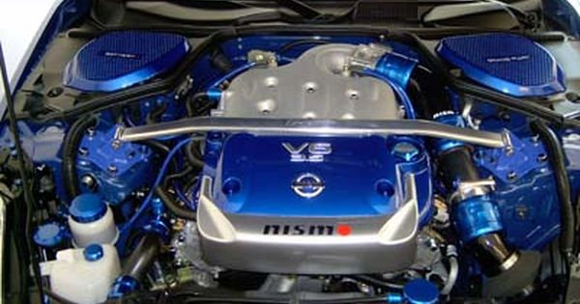
Parts Under the Hood
Engine
Transmission
Radiator
AC Compressor
Alternator
Battery
Windshield Wiper Fluid
Water Pump
Power Steering Pump
Oil Filter

Slide 17
Christmas Symbols
6

Slide 19
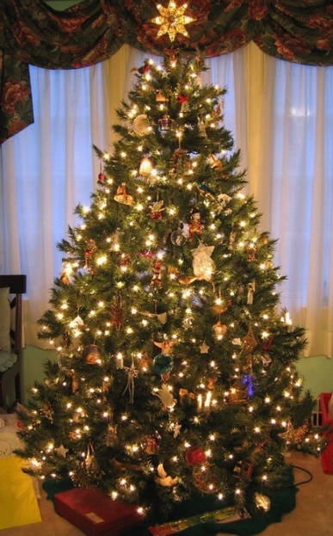
Christmas Symbols
Christmas Tree
Wreath
Stocking
Bells
Star
Nativity Scene
Santa Clause
Elves
Mistletoe
Candle

Slide 20
Music Rappers
7

Slide 22
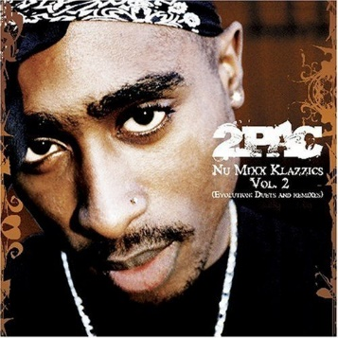
Rappers
2Pac
Drake
Eminem
Ludacris
Snoop Dogg
Macklemore
2Chains
Nikki Minaj
Jay-Z
Lil’ Wayne

Slide 23
States with the Largest Population
8

Slide 25
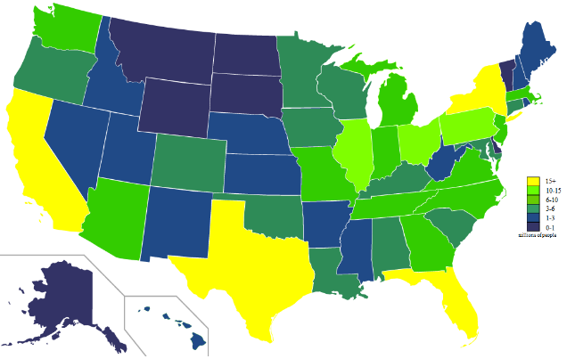
States with the Largest Population
California
Texas
New York
Florida
Illinois
Pennsylvania
Ohio
Georgia
Michigan
North Carolina

Slide 26
Winter Olympic Events
9

Slide 28
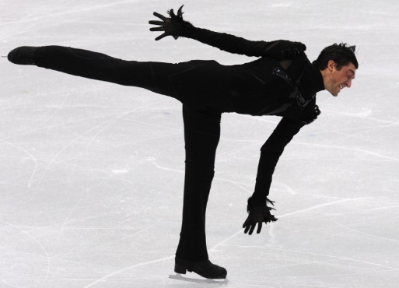
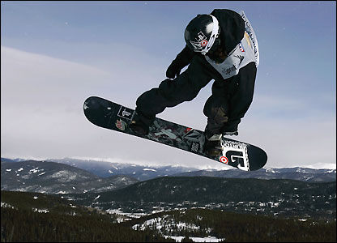
Major Sporting Events
Slalom
Figure Skating
Curling
Snowboarding
Half-Pipe
Bobsledding
Luge
Speed Skating
Ice Hockey
Ski Jumping

Slide 29
Things covered with chocolate
10

Slide 31
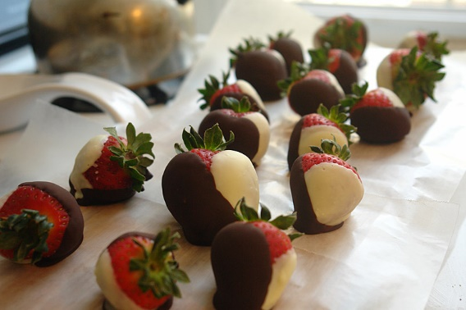
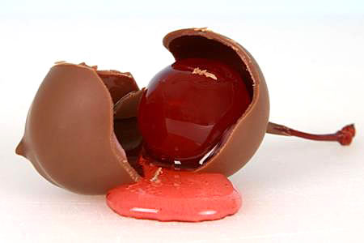
Things covered with Chocolate
Strawberries
Raisins
Candy
Caramel
Bananas
Pretzels
Peanuts
Cherries
Gummy Bears
Almonds

