Slide 1

Game #8

Slide 2

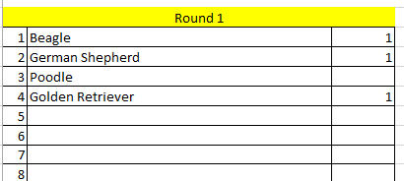
Directions:
A category will be given to you. Type as many answers as you can—things that that category makes you think of. When time is up, ten items will be listed. You get 1 point for every item on your list that matches the list provided.

Slide 3

Water Sports
1

Slide 4


Slide 5
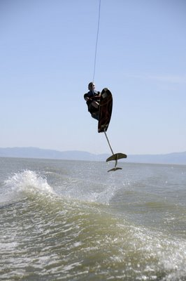
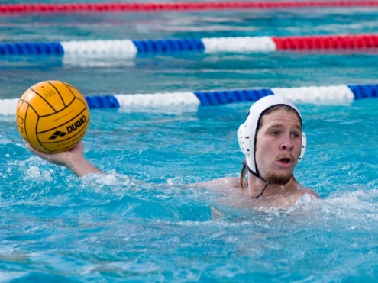
Water Sports
Swimming
Diving
Water Skiing
Hydofoiling
Marco Polo
Water Volleyball
Synchronized Swimming
Triathlon
Paddleboarding
Snorkeling

Slide 6
Things You Take with you On
Vacation
2

Slide 8
Things You Take with you on Vacation
Plane Tickets
Towels
Swimsuit
Suitcase
Money
Sunscreen
Family
Camera
Hygiene Items
Book

Slide 9
Countries in Europe
3

Slide 11
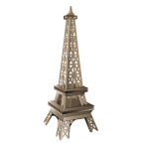
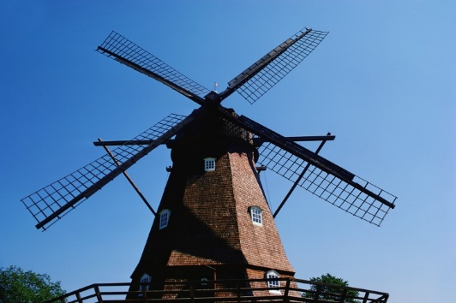
Countries in Europe
France
England
Denmark
Sweden
Italy
Belgium
Holland
Germany
Spain
Portugal

Slide 12
Math Vocabulary
4

Slide 14
Math Vocabulary
Integer
Addition
Multiplication
Division
Subtraction
Simplify
Equals
Polygon
Pythagoras
Denominator

Slide 15
Rides at Disneyland
(NOT California Adventure)
5

Slide 17
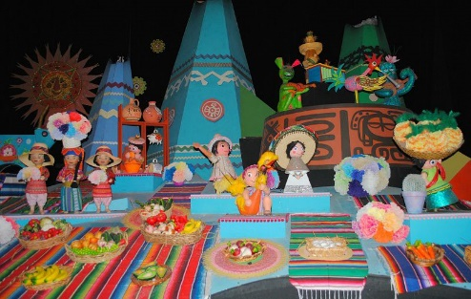
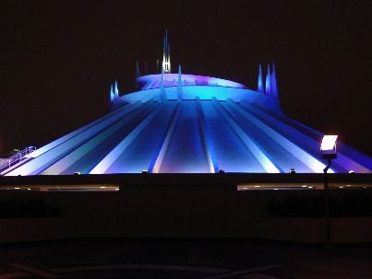
Rides at Disneyland
Pirates of the Caribbean
Haunted Mansion
Big Thunder Mountain Railroad
Splash Mountain
Matterhorn
Star Tours
Space Mountain
Guardians of the Galaxy
It’s a Small World
Indiana Jones

Slide 18
Napoleon Dynamite
6

Slide 20
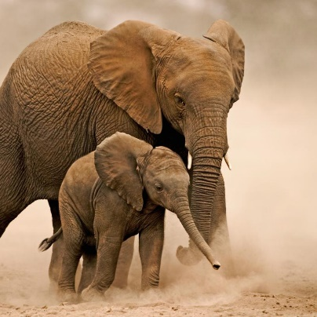
African Animals
Lion
Rhinoceros
Leopard
Giraffe
Hippopotamus
Cheetah
Antelope
Hyena
Elephant
Baboon

Slide 21
Scientific Method
7

Slide 23

Scientific Method
Theorem
Hypothesis
Conclusion
Experiment
Analysis
Observation
Prediction
Testing
Theory
Question

Slide 24
American Car Brands
8

Slide 26

American Car Brands
Jeep
Ram
Buick
Ford
Lincoln
Chrysler
Chevrolet
GMC
Dodge
Tesla

Slide 27
Fairytales
9

Slide 29
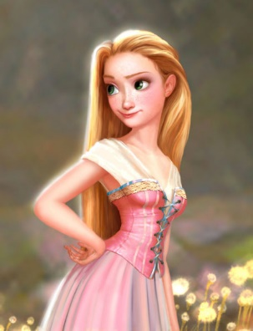
Fairy Tales
Cinderella
Sleeping Beauty
Rapunzel
Princess and the Pea
Frog Prince
Snow White
Jack and the Beanstalk
Rumplestilskin
Beauty and the Beast
Thumbelina

Slide 30
Broadway Musicals
10

Slide 32

Broadway Musicals
Wicked
Phantom of the Opera
Les Miserables
Hairspray
Chicago
Hamilton
Joseph & the Amazing Technicolor Dreamcoat
Lion King
Crazy for You
Rent

